Slide 1
Midterm Project of Machine Vision EAN-13 Barcode Reader
Adviser: Prof. Chi Cheng Cheng
Student: Chia Sheng Kuo
Student ID: M063020037
Dept. of Mechanical and Electro-Mechanical Engineering National Sun Yat-Sen University

Slide 2
Outline
Strategy
Function.m
Result
Prospective
Project demo

Slide 3
Strategy

Slide 4
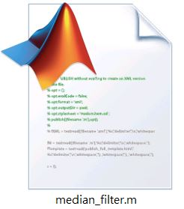
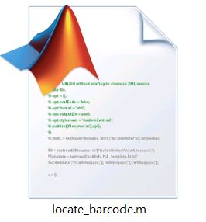
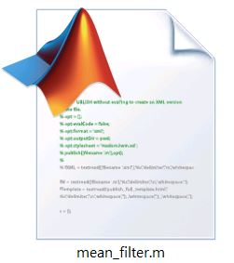
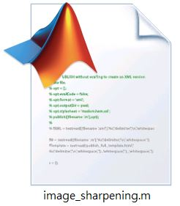




Block diagram of the proposed procedure
Input Image
Barcode Locator
Image Processing
Barcode Decoder
Output Barcode Numbers

Slide 5
Function.m

Slide 6
Input Image
Barcode Locator
Image Processing
Barcode Decoder
Output Barcode Numbers

Slide 7
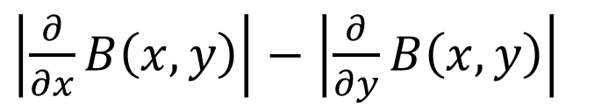
locate_barcode.m & meaidan_filter.m
High horizontal gradient
Low vertical gradient
Median filter
$\left|\frac{∂}{∂x}B\left(x,y\right)\right|$ $−$ $\left|\frac{∂}{∂y}B\left(x,y\right)\right|$
(i-1 , j-1)
(i-1 , j)
(i-1 , j+1)
1
1
-1
(i , j-1)
Median
(i , j+1)
-1
(i+1 , j-1)
(i +1, j)
(i+1 , j+1)
Pixels with relatively high value assumed to be where the barcode locates.

Slide 8
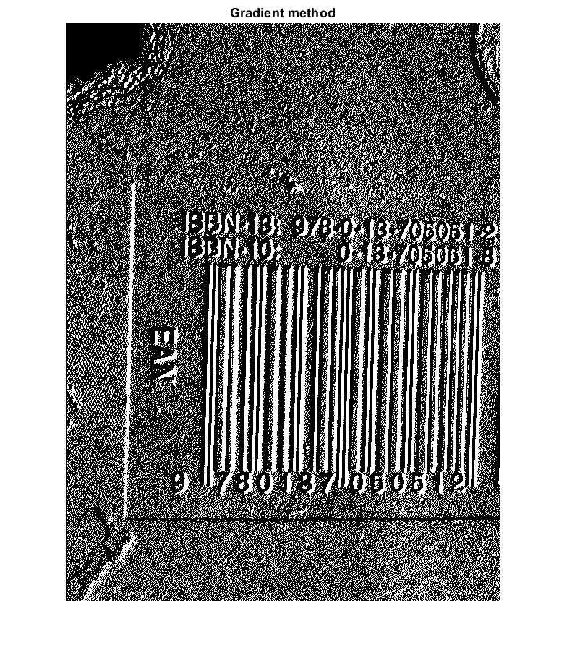
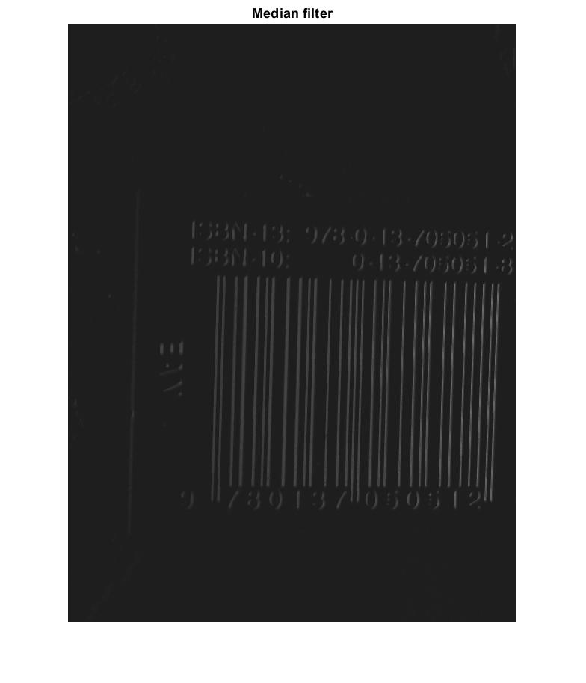
Test 1

Slide 9
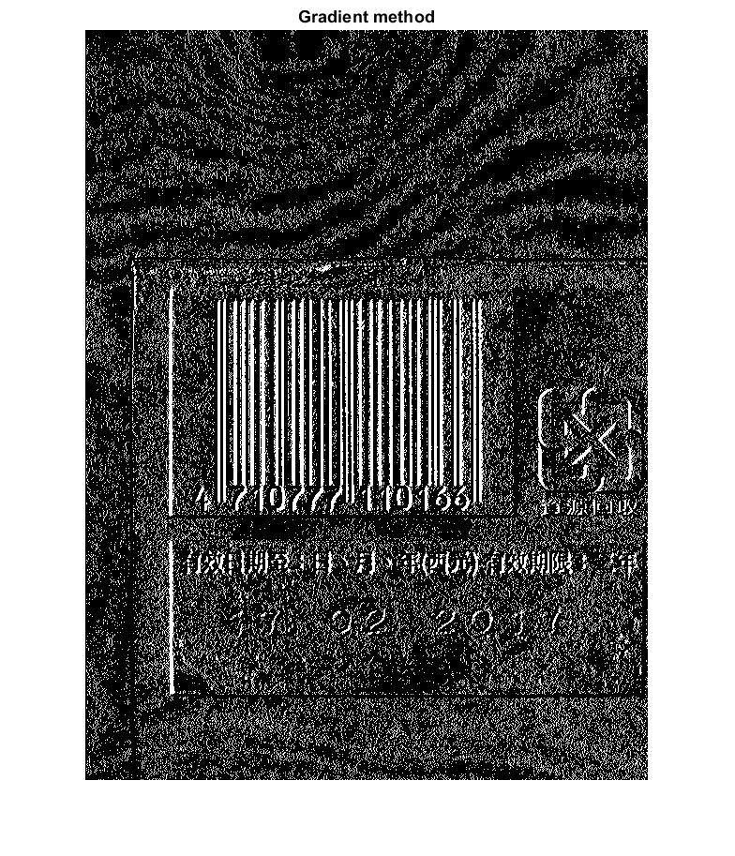
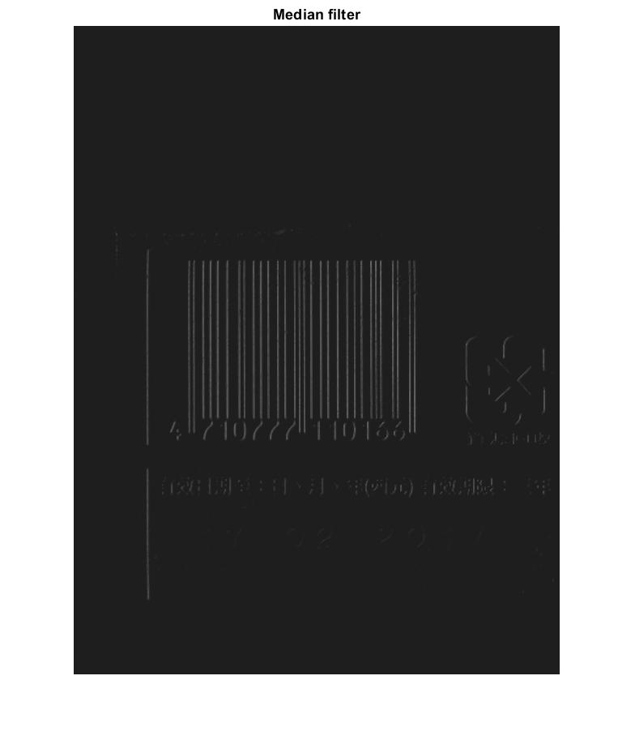
Test 2

Slide 10
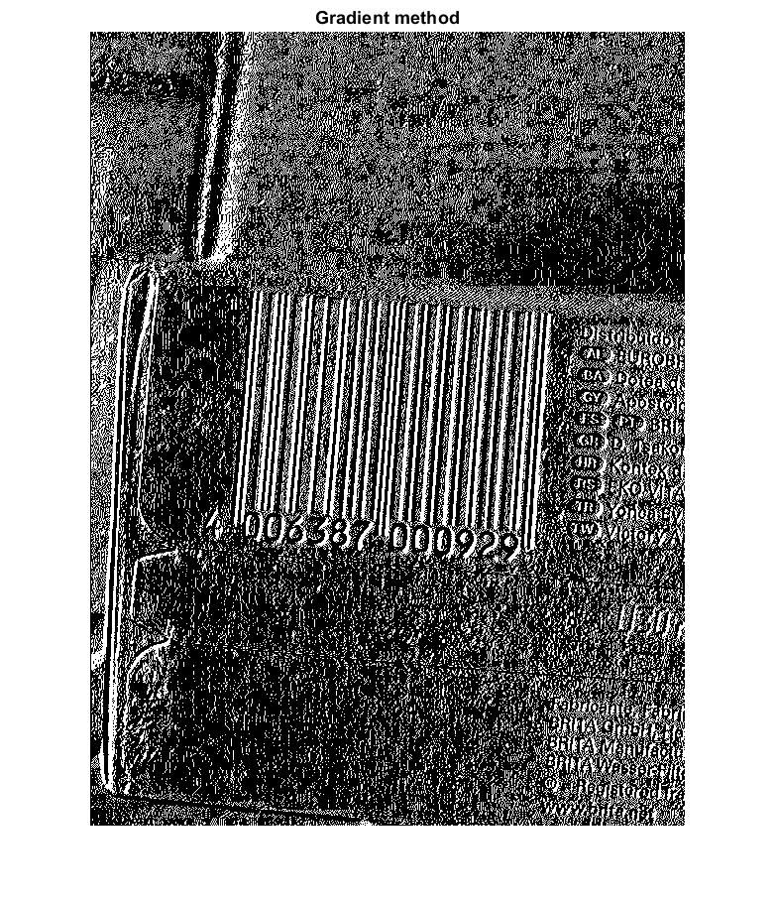
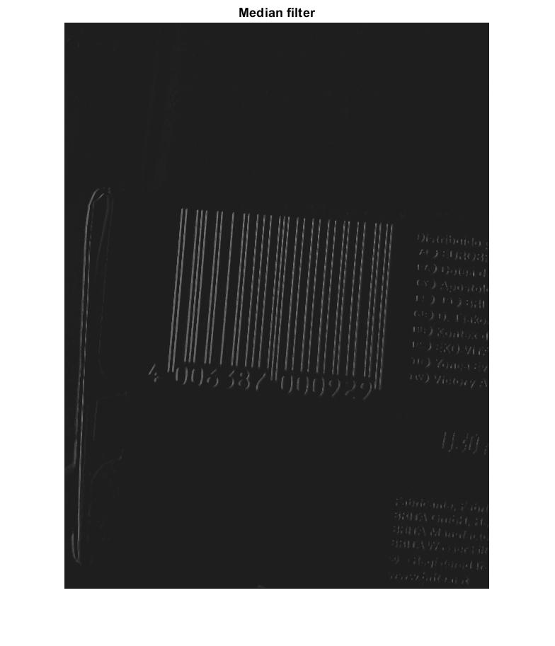
Test 3

Slide 11
Two algorithms to find i & j directional boundaries
For i direction, rows in the barcode region appear to have high frequency of changing 1 to 0 and 0 to 1.
j
i
0 | 0 | 0 | 0 | 0 | 0 | 0 | 0 | 0 | 0 | 0 | 0 | 0 | 0 | 0 | 0 | 0 | 1 | 0 | 0 | 0 | 0 | 0 | 2
1 | 0 | 0 | 0 | 0 | 1 | 1 | 0 | 0 | 0 | 0 | 0 | 0 | 0 | 0 | 0 | 0 | 1 | 0 | 0 | 0 | 0 | 1 | 6
0 | 0 | 0 | 1 | 0 | 0 | 0 | 1 | 0 | 1 | 0 | 1 | 1 | 0 | 0 | 1 | 0 | 1 | 0 | 0 | 0 | 1 | 0 | 14
0 | 0 | 0 | 1 | 0 | 0 | 0 | 1 | 0 | 1 | 0 | 1 | 1 | 0 | 0 | 1 | 0 | 1 | 0 | 0 | 0 | 0 | 0 | 12
0 | 0 | 1 | 1 | 0 | 0 | 0 | 1 | 0 | 1 | 0 | 1 | 1 | 0 | 0 | 1 | 0 | 1 | 0 | 0 | 0 | 1 | 0 | 14
0 | 0 | 0 | 1 | 0 | 0 | 0 | 1 | 0 | 1 | 0 | 1 | 1 | 0 | 0 | 1 | 0 | 1 | 0 | 0 | 0 | 1 | 0 | 14
0 | 0 | 0 | 1 | 0 | 0 | 0 | 1 | 0 | 1 | 0 | 1 | 1 | 0 | 0 | 1 | 0 | 1 | 0 | 0 | 0 | 0 | 0 | 12
0 | 0 | 0 | 0 | 0 | 0 | 0 | 1 | 0 | 1 | 0 | 1 | 1 | 0 | 0 | 1 | 0 | 1 | 0 | 0 | 0 | 0 | 0 | 10
0 | 0 | 0 | 0 | 0 | 0 | 0 | 0 | 0 | 1 | 0 | 0 | 0 | 0 | 0 | 0 | 0 | 0 | 0 | 0 | 0 | 0 | 0 | 2
1 | 0 | 0 | 0 | 0 | 0 | 0 | 0 | 0 | 0 | 1 | 0 | 0 | 0 | 0 | 0 | 0 | 0 | 0 | 0 | 0 | 0 | 0 | 3

Slide 12
After applying convolution with a one row mask, the boundary in j direction will be obvious.
j
i
0 | 0 | 0 | 1 | 0 | 0 | 0 | 1 | 0 | 1 | 0 | 1 | 1 | 0 | 0 | 1 | 0 | 1 | 0 | 0 | 0 | 1 | 0
0 | 0 | 0 | 1 | 0 | 0 | 0 | 1 | 0 | 1 | 0 | 1 | 1 | 0 | 0 | 1 | 0 | 1 | 0 | 0 | 0 | 0 | 0
0 | 0 | 1 | 1 | 0 | 0 | 0 | 1 | 0 | 1 | 0 | 1 | 1 | 0 | 0 | 1 | 0 | 1 | 0 | 0 | 0 | 1 | 0
0 | 0 | 0 | 1 | 0 | 0 | 0 | 1 | 0 | 1 | 0 | 1 | 1 | 0 | 0 | 1 | 0 | 1 | 0 | 0 | 0 | 1 | 0
0 | 0 | 0 | 1 | 0 | 0 | 0 | 1 | 0 | 1 | 0 | 1 | 1 | 0 | 0 | 1 | 0 | 1 | 0 | 0 | 0 | 0 | 0
0 | 0 | 0 | 0 | 0 | 0 | 0 | 1 | 0 | 1 | 0 | 1 | 1 | 0 | 0 | 1 | 0 | 1 | 0 | 0 | 0 | 0 | 0
0 | 0 | 1 | 5 | 0 | 0 | 0 | 6 | 0 | 6 | 0 | 6 | 6 | 0 | 0 | 6 | 0 | 6 | 0 | 0 | 0 | 3 | 0
 |  | 6 | 6 | 6 | 11 | 6 | 12 | 12 | 18 | 18 | 18 | 12 | 18 | 12 | 12 | 12 | 12 | 6 | 9 | 3
(i , j-2)
(i , j-1)
(i , j)
(i , j+1)
(i , j+2)

Slide 13
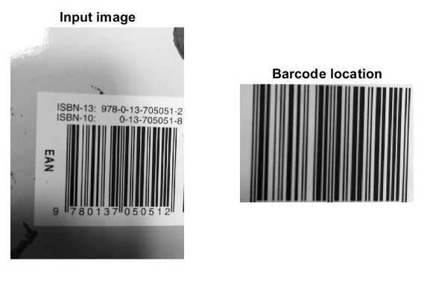
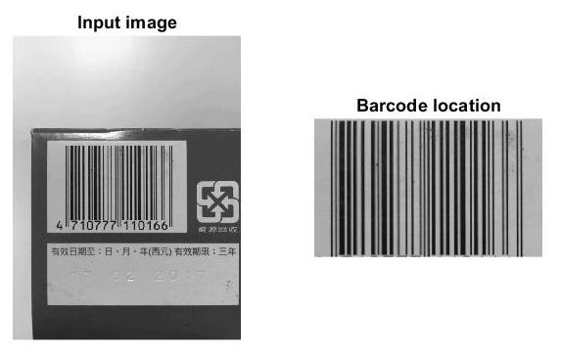
Test 1 & 2

Slide 14
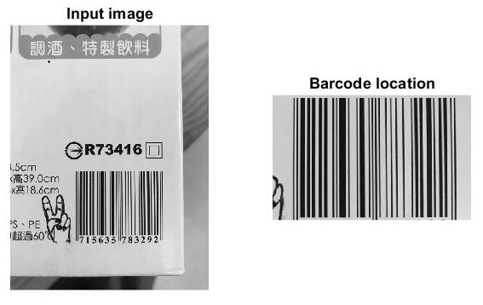
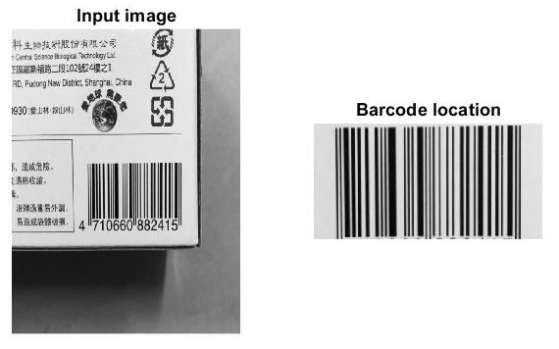
Test 3 & 4

Slide 15
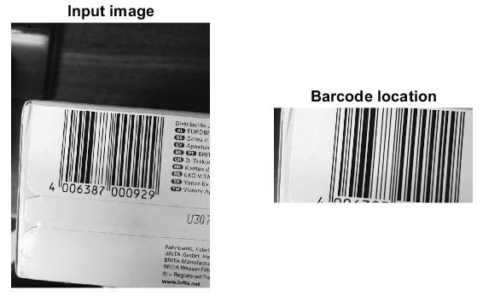
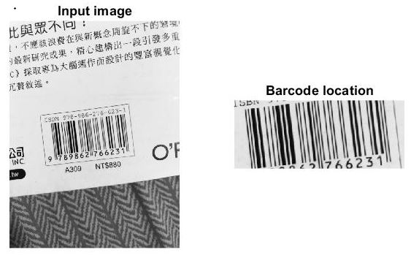
Test 5 & 6

Slide 16
Input Image
Barcode Locator
Image Processing
Barcode Decoder
Output Barcode Numbers

Slide 17









mean_filter.m
Mean filter
$$\frac{1}{9}$$
$$\frac{1}{9}$$
$$\frac{1}{9}$$
Any feature with a sharp discontinuity, like noise, will be enhanced by a Laplacian operator.
$$\frac{1}{9}$$
$$\frac{1}{9}$$
$$\frac{1}{9}$$
$$\frac{1}{9}$$
$$\frac{1}{9}$$
$$\frac{1}{9}$$
Noises in an image have to be smoothed in advance.

Slide 18
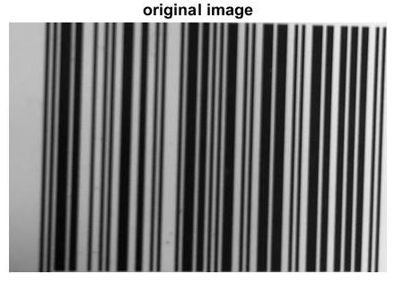
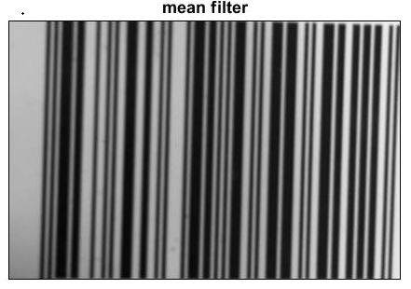
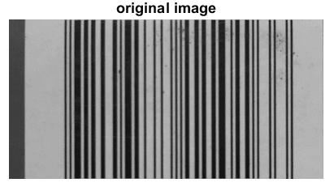
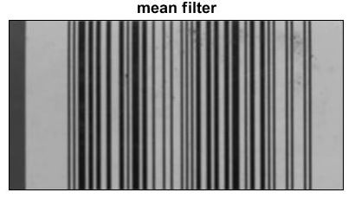
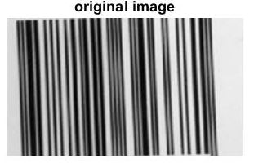
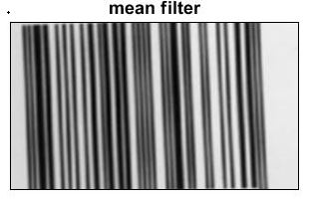
Test 1 & 2 & 3

Slide 19
image_sharpening.m
Laplacian operator
-1
-4
-1
Add the result to the original image in order to sharpen the image.
-4
20
-4
-1
-4
-1

Slide 20
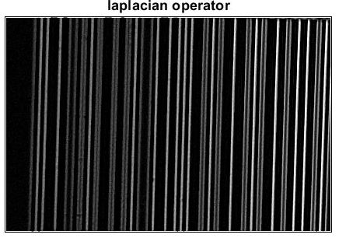
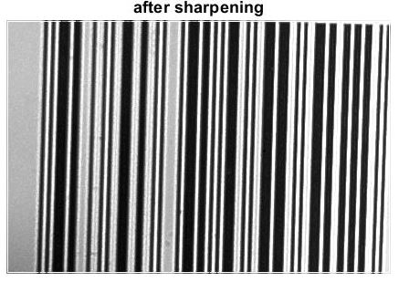
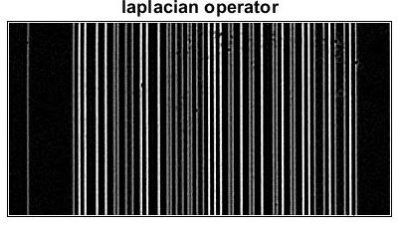
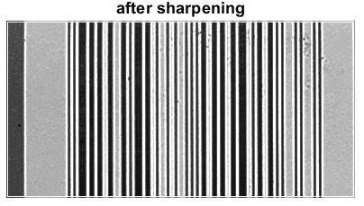
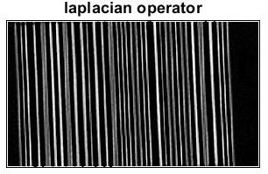
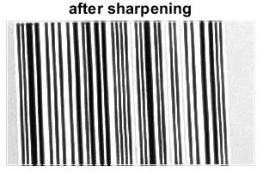
Test 1 & 2 & 3

Slide 21
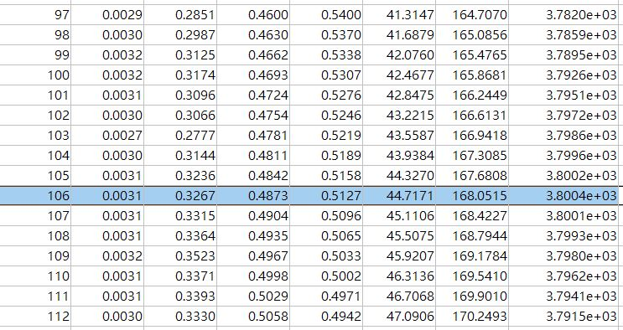

barcode_binary_processing.m
1. The technique is to test each gray value which exists in the image to serve as a threshold and use it to separate the image in to two groups A and B.
2. There is only one gray value that corresponds to the biggest variance between group A and B.
Ostu’s thresholding
$${σ_{B}}^{2}$$
T
A
B

Slide 22
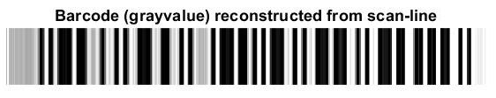
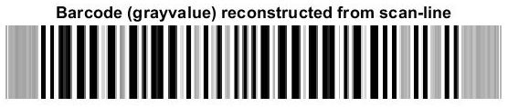
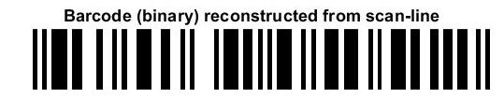
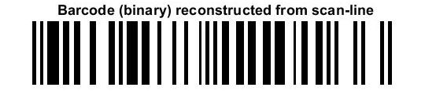
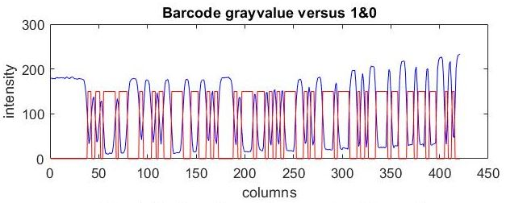
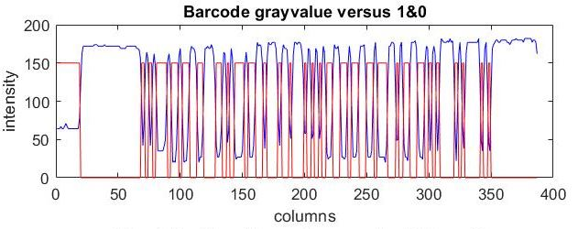
After thresholding, the middle row is determined to be a scan line and this information will be sent to the read_barcode.m.
Test 1
Test 2

Slide 23
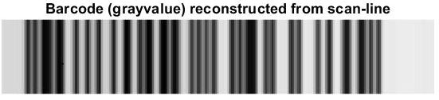
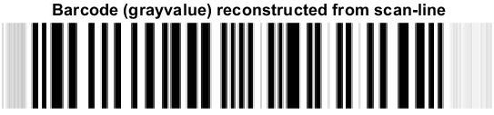
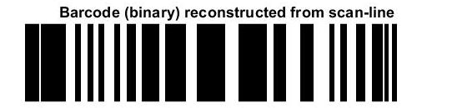
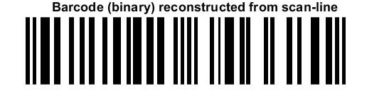
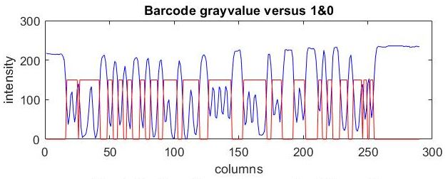

Test 3
Without sharpening
After sharpening

Slide 24
Input Image
Barcode Locator
Image Processing
Barcode Decoder
Output Barcode Numbers

Slide 25


read_barcode.m
Divided by PPD & read by barcode_decoding.m
Run-length encoding
Total pixels from left hand guard to right hand guard divided by 95 = pixel per digit.

Slide 26
barcode_decoding.m
Left-hand guard | Center guard | Right-hand guard
111 | 11111 | 111
Character set encoding table
Digit | Left-hand
 | Right-hand
 | Odd parity | Even parity
0 | 3211 | 1123
1 | 2221 | 1222
2 | 2122 | 2212
3 | 1411 | 1141
4 | 1132 | 2311
5 | 1231 | 1321
6 | 1114 | 4111
7 | 1312 | 2131
8 | 1213 | 3121
9 | 3112 | 2113
3+6*4+5+6*4+3 = 59 rows
To decode the barcode in a run-length encoding way can avoid the cumulative error caused by the image noises.

Slide 27



check_sum_digit.m
If there is only one error in barcode_decoding.m, the error can be fixed by the checksum digit.
The checksum digit rule
( 3+6+7+6+9+7)*3 + ( 0+6+2+8+8+9) +1 = 148
For example:
Take ceiling(148/10) -148 = 2
Left
1st
errors
Right
errors
Error fixed
First digits = 9

Slide 28
Result

Slide 29

Test 1-12 | No problem
Test 13 | 1 error, solved by checksum digit.
Test 3,14 | Too much errors
Test 15-17 | The program can’t solve

Slide 30
Prospective

Slide 31
Preprocessing
The shortcoming of my barcode reader is that this program can only deal with horizontal or nearly horizontal barcode.
Input Image
Barcode Locator
To fix this problem, a preprocessing technique have to be developed.
Image Processing
A Sobel operator and a Hough transform could be adopted.
Barcode Decoder
Output Barcode Numbers

Slide 32
Project demo

